Slide 1
The AP® Program
at
MOUNT HEBRON HIGH SCHOOL

Slide 2
Dr. Miller, Principal
Dr. Kiehl, AP Coordinator
Brittany Gutierrez, ITL
Don Walters, ITL
Dina Reyes, ITL

Slide 3
The Basics
Advanced Placement Program® (AP®) courses are college-level courses offered in high school. AP courses reflect what is taught in top introductory college courses.
At the end of course, students take AP Exams—standardized exams that measure how well students have mastered college-level course work.
Students who do well on AP Exams can earn credit and/or placement into advanced courses in college.

Slide 4
The Benefits of AP Courses
AP courses can be challenging, but it’s work that pays off.
AP courses are often the most interesting and fulfilling courses a student takes in high school.
Students develop confidence, and learn the study habits and time management skills essential for success in college.

Slide 5
AP and College Admission
Colleges rank “Grades in college prep courses” and “Strength of curriculum” as the top two factors in the admission decision.*
85% of selective colleges and universities report that a student’s AP experience favorably impacts admission decisions.**
“We look favorably on students who have taken AP courses. The presence of AP courses is a sign that a student has chosen to challenge him/herself.”
—Admission Officer
* 2018 State of College Admission, NACAC
** Unpublished institutional research, Crux Research Inc. March 2007
Notes:
**For the purposes of this study, “selective” institutions were defined as those where less than 70 percent of applicants were admitted, the mean SAT score was 1025 or higher, and mean ACT score was 22 or higher.

Slide 6
AP and College Success
Students who earned a 3, 4, or 5 on the AP Exam had higher first-year college grade point averages and were more likely to return for the second year of college than non-AP students of similar ability. *
GPA for college students in their first semester is an average of .15 higher for students who took an AP class in high school. **
“One of the best standard predictors of academic success at Harvard is performance on Advanced Placement Examinations.”
—William Fitzsimmons, Dean of Admissions & Financial Aid, Harvard University
*Krista Mattern, Emily Shaw, and Xinhui Xiong, “The Relationship Between AP Exam Performance and College Outcomes” (2009), The College Board.
**Wyatt, J., Patterson, B. F. & Di Giacomo, F. T. (in press). A comparison of the college outcomes of AP and dual enrollment students. (College Board Research Report, in press). New York: The College Board.

Slide 7
AP Helps Students Graduate College on Time
… and Save Money
Students who take AP courses and exams are much more likely than their peers to complete a college degree on time. *
The retention rate for college students is an average of 7.0% higher for students who took an AP class in high school. **
Students who take five years or more to graduate spend an average $21,500 for each additional year in college.
* The College Board, College Outcomes Comparisons by AP and Non-AP High School Experiences, 2008
** IPEDS database, 2008
SOURCE: The College Board, Trends in College Pricing 2011, Figure 1
Notes:
* Of the remaining students who do not complete a bachelor’s degree in four years, approximately 25% earn a bachelor’s degree in 5 or 6 years, approximately 25% drop out or take more than 6 years to earn a bachelor’s degree, and approximately 23% transfer to another college or university, with typically lower graduation rates than students who do not transfer.

Slide 8
AP and College Success
31% of colleges and universities consider a student’s AP experience when making decisions about which students will receive scholarships.*
“Having the AP Exam score can make the difference when it comes down to awarding precious scholarship dollars.”
—Edwina Harris Hamby, former Dean of Admission, Fisk University
Students who take AP courses are more likely to graduate, more likely to graduate on time, and save money on tuition.
* Unpublished institutional research, Crux Research Inc. March 2007

Slide 9
What Are AP Courses Like?
AP courses typically demand more of students than regular or honors courses.
Classes tend to be fast-paced and cover more material than typical high school classes.
More time, inside and outside of the classroom, is required to complete lessons, assignments and homework.
AP teachers expect their students to think critically, analyze and synthesize facts and data, weigh competing perspectives, and write clearly and persuasively.
Notes:
Possible slide for a student presenter - Discussion topic: How can parents help support their children?
Encourage time management
Remind them to prioritize
Recommend they form study groups
Designate specific areas for homework and studying

Slide 10
AP Courses Offered at
Mt. Hebron
FINE ARTS
Art 3 Portfolio Development
Art 4 Personal Directions in Art
Photo AP
Music Theory AP
SCIENCE
Biology AP
Chemistry AP
Environmental Science AP
Physics 1 – Algebra-based AP
Physics C: Electricity and Magnetism AP
Physics C: Mechanics AP
MATH
Calculus AB AP
Calculus BC AP
Statistics AP
SELF STUDY
COMPUTER SCIENCE
Computer Science A-AP
Computer Science Principles AP
ENGLISH
English 11 AP
English 12 AP
SOCIAL STUDIES
Government and Politics AP
Psychology AP
U.S. History AP
World History AP
Economics AP (Macro/Micro)
European History AP
Comparative Government AP
Human Geography AP
WORLD LANGUAGES
Spanish 5 AP
French 5 AP
German AP

Slide 11
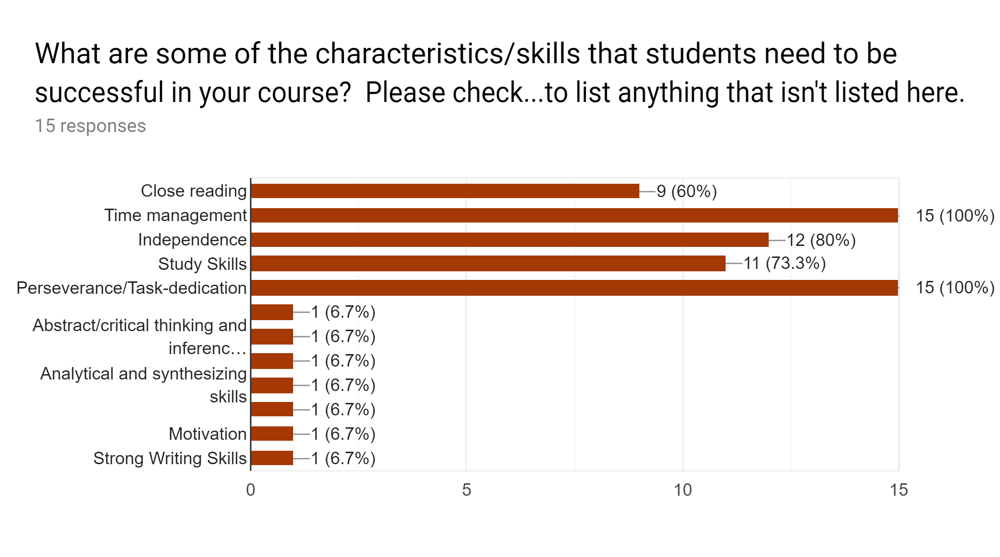
Success at Mt. Hebron

Slide 12
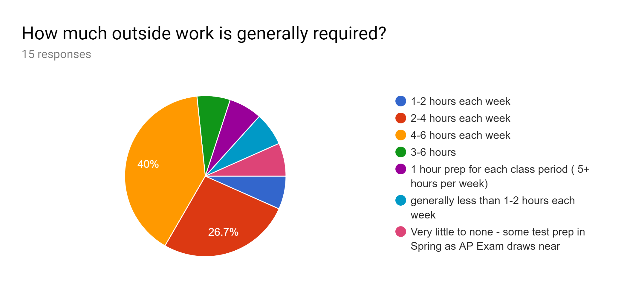
Success at Mt. Hebron

Slide 13
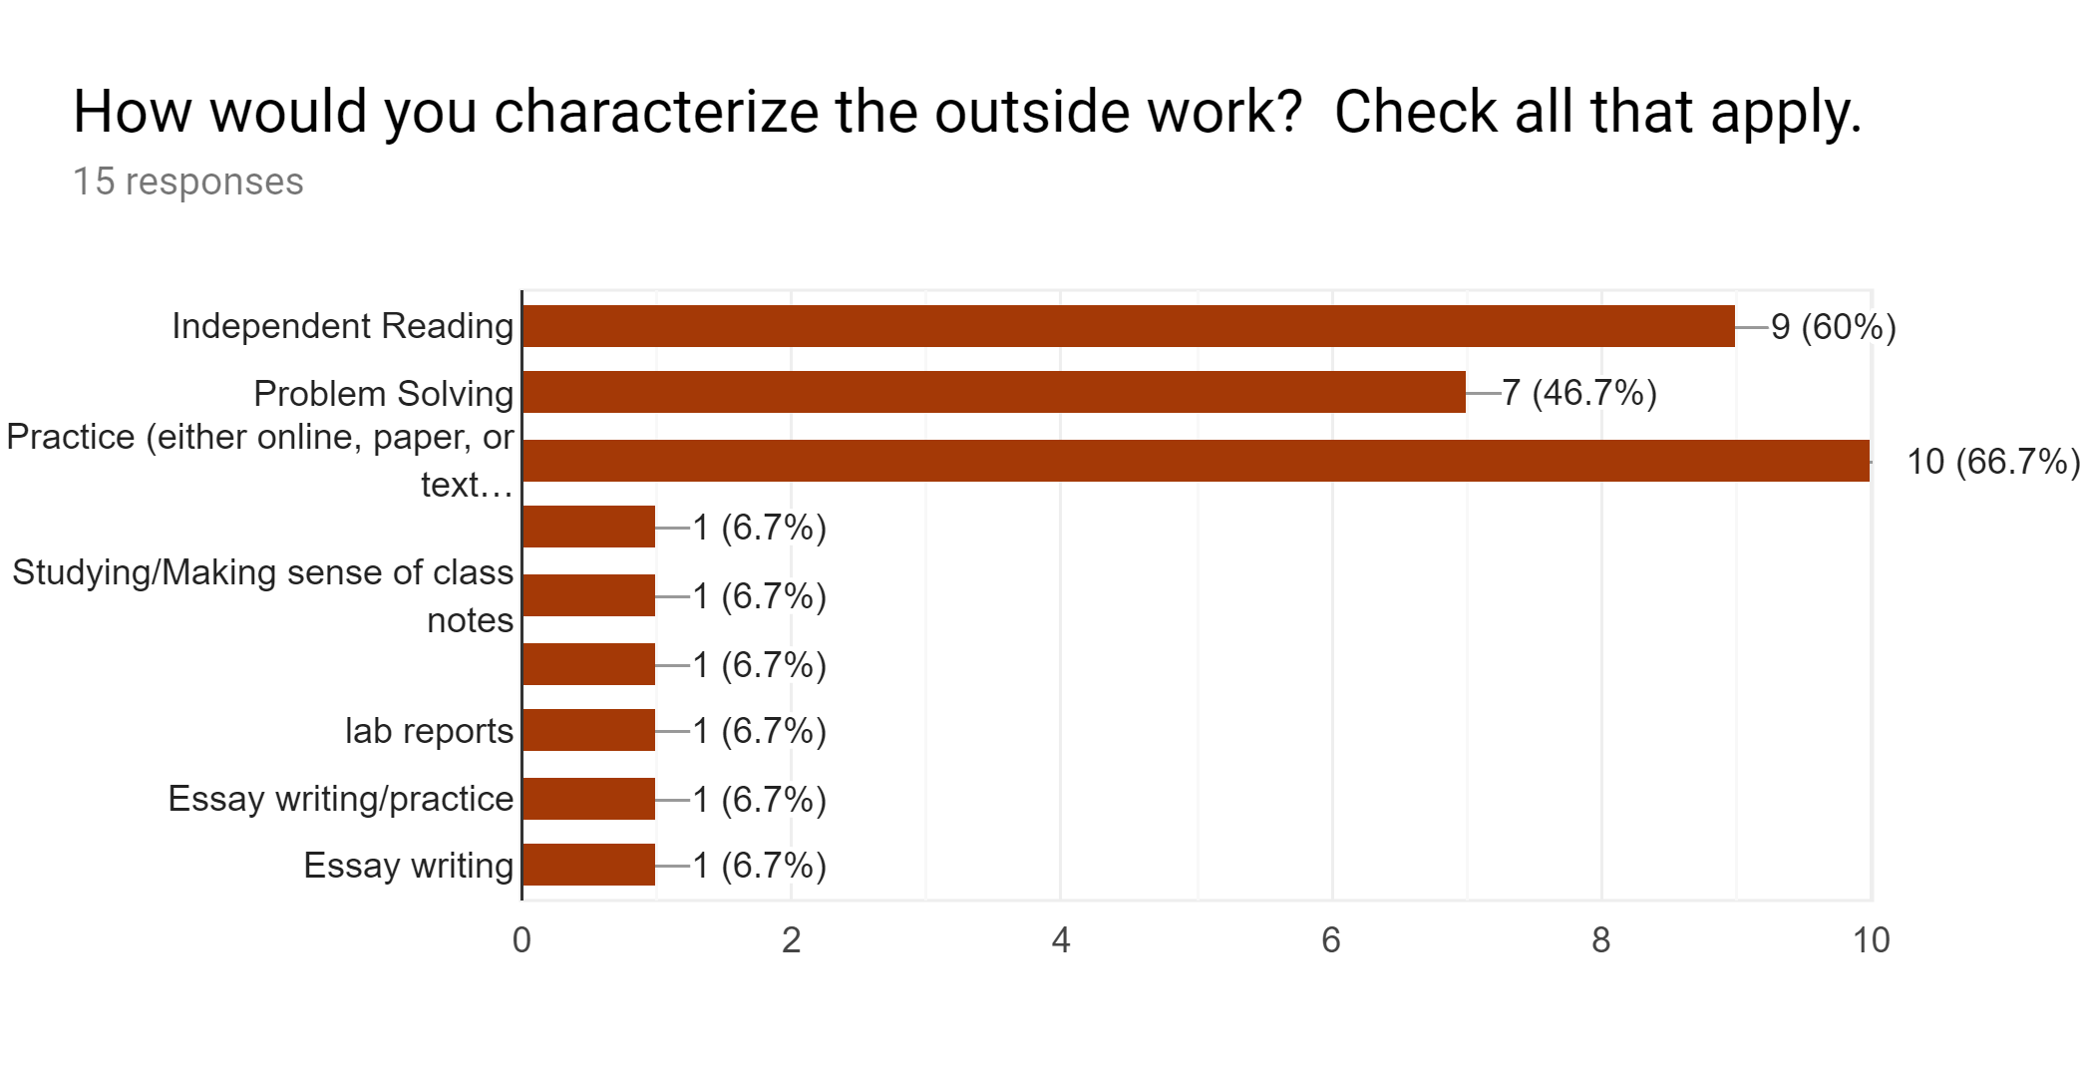
Success at Mt. Hebron

Slide 14
AP Exams
AP Exams are the first two full weeks in May.
Exams usually last around 3-4 hours.
Most AP Exams contain: Multiple-choice questions and Free-response questions
The AP Exam fee for 2019 is $94.
Financial Assistance is available for families with demonstrated need (FARMS, etc.).

Slide 15
Exam Registration Changes
Through this school year, students will register to the AP exams in March.
Beginning in the 2019-2020 school year, students will register in October/November.
This is directed by College Board and cannot be changed by the school or HCPSS.

Slide 16
Why Take AP Exams?
Most two- and four-year colleges and universities in the United States offer credit or advanced placement for qualifying AP Exam scores.
Credit: Students earn credit toward their college degrees.
Advanced placement: Students can skip introductory courses and move directly into higher-level classes, and/or fulfill general education requirements.
Each college and university has its own policies regarding credit and placement. The College Board offers information about AP credit at thousands of college and universities at www.collegeboard.org/apcreditpolicy

Slide 17
Mt. Hebron’s Stats!
2017-2018 School Year
1566 students at Mt. Hebron - 622 in AP courses (40%)
520 of the 622 students took at least one exam (84%)
Those students took 1141 exams - 85% of those exams earned a 3, 4, or 5!

Slide 18
AP Scholars at MHHS
Students who earn a score of 3 or higher on multiple AP exams earn AP Scholar status. In 2017-2018, MHHS students demonstrated college level achievement with:
74 AP Scholars
47 AP Scholars with Honors
114 AP Scholars with Distinction
28 National Scholars
263 of our 520 test-takers are AP Scholars.
This looks great on college applications!

Slide 19
Summary: College Success with AP
Students who took one or more AP courses and exams in high school have:
higher college GPAs
earn more credit hours
are more likely to graduate in four years or less

Slide 20
Sign up for an AP course today!
Questions?
AP Teachers will be available in the cafeteria to answer questions.

